Slide 1
ROZANAH KATRINA HERDA, M.Pd
ASKING AND GIVING SUGGESTION

Slide 2
I'm having trouble in English class.
Suggestions:
You could talk to your teacher.
You could ask Michelle to help you with your math lessons.
I could try to help you.

Slide 3
Asking & Giving suggestions
Anton : I have a serious problem today. I have just lost my driver license.
Shally : Don't be so sad, let us search it around the park.
Anton : I have looked for it for hours but I do not find it, do you have some ideas?
Shally : You had better tell the securities to announce it to other students.
Anton : Yeah, that sounds good. I do hope it helps.

Slide 4
MODAL VERBS
The modal verbs include can, must, may, might, will, would, should. They are used with other verbs to express ability, obligation, possibility, and so on.

Slide 5
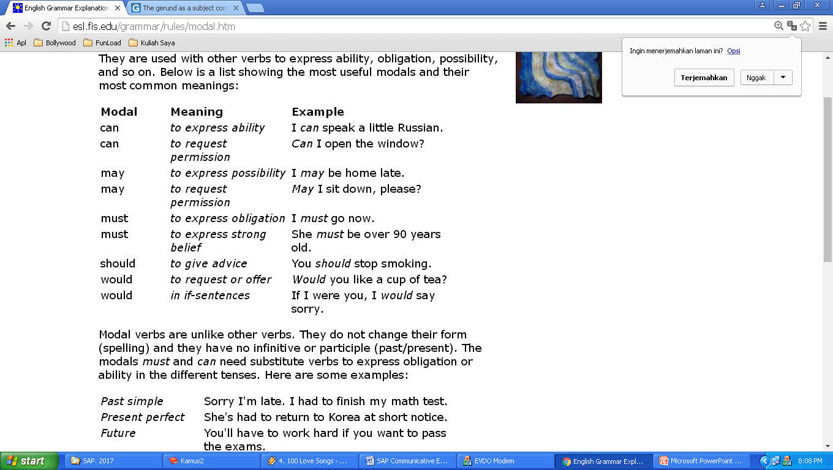

Slide 6
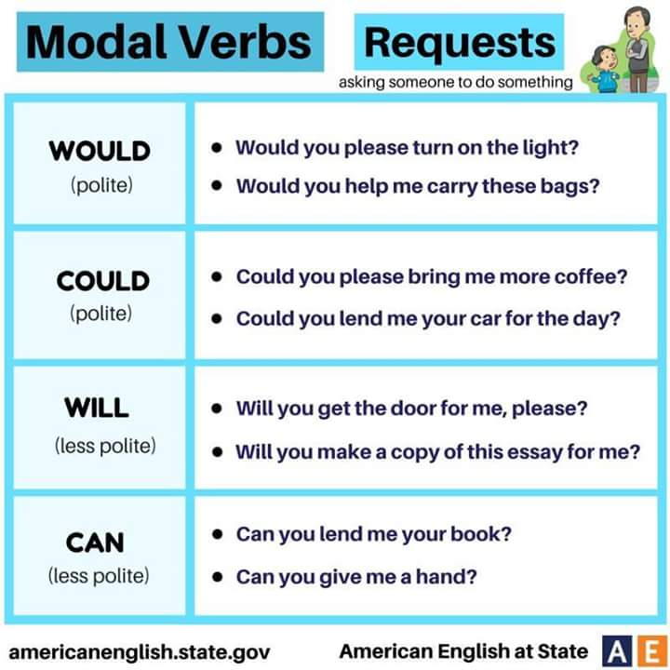

Slide 7
to-infinitive clause can be a subject complement after be:
My advice is to file a complaint at once.
What is essential is to maintain a healthy diet.
The decision was to extend the deadline by
three months.

Slide 8
ASKING SUGGESTION | GIVING SUGGESTION
Do you have any ideas for me? | You should + V1
Do you have any suggestions for me? | You had better + V1
Do you have any advice for me? | You ought to + V1
Would you mind giving me your suggestion? | I advise you to + V1
Can you tell me what I should do? | I suggest you to + V1
What should I do? | I recommend you to + V1
Doctor, do you have any advice for my sore throat? | For a sore throat, it’s a good idea to take a bottle of throat spray

Slide 9
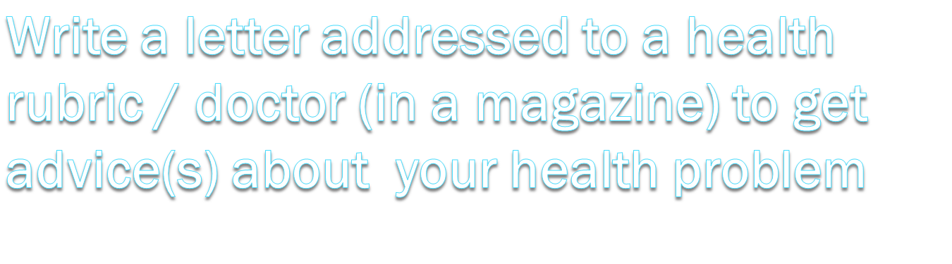

INDIVIDUAL TASK
ASK ME A QUESTION, PLEASE!

